Slide 1

Creating Software Ventures
CAPITALIZATION
Powerpoint Templates

Slide 2
Capitalization Table
Also called a "Cap Table“
Table showing the total amount of the various securities issued by a firm.
Lists the amount of investment obtained from each source and the securities distributed
Common and Preferred shares, Options, Warrants, etc.
Shows respective ownership percentages.

Slide 3
Microsoft
http://finance.yahoo.com/q/mh?s=MSFT

Slide 4
Cap Table Calculations
Pre-money Valuation + Investment = Post-money Valuation
Share price = Investment / number of shares to Investors
Market Cap = total num of Shares * Share price
Ownership % = Shares owned / total outstanding Shares

Slide 5
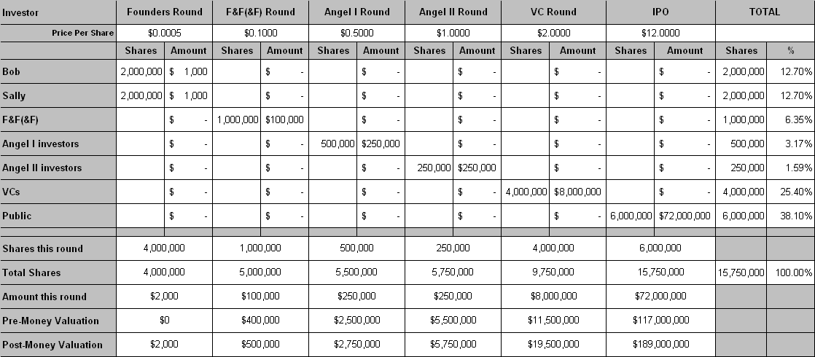
Cap Table Planning
1- Founders
2- Investors
3- Totals

Slide 6
Cap Table Planning
Founders Round
Founding
Start with 1-10 million shares
Capitalize with amount contributed (minimal)
Totals of
Founders Round

Slide 7
Cap Table Planning
Friends & Family Round
Friends & Family
Usually cheap common stock
Seed money to get the company started
Pitfalls
Totals including
Friends & Family Round

Slide 8
Cap Table Planning
Angel Round
Angel Investors
Usually preferred stock
Could be debt
Enough to take to major milestone or even cash flow positive or profitability
Totals including
Angel Round

Slide 9
Cap Table Planning

Slide 10
Cap Table Planning

Slide 11
Cap Table Planning

Slide 12
Cap Table Planning

Slide 13

2 Common Mistakes by Startups
1. No formal organization
Select business structure
Determine who owns what
Execute founding documents
2. No financial plan
Proforma - 12-24 months of monthly cash flow projections
Tells you your cash and capital needs

Slide 14
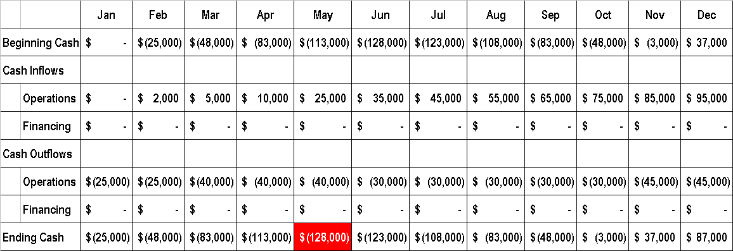
Proforma - Financial Projections
Detailed, time-consuming process
Most businesses start off with a cash flow J-curve

Slide 15
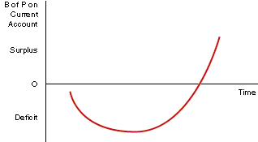
How much capital?
Add 20-50% to the low point n the J-curve
This is how much money (capital) should be raised
$128,000
20-50% Buffer
$200,000

